Slide 1
TensorFlow Workshop

Slide 2
Introduction
What is Machine Learning?
What is TensorFlow and how is it used in Machine Learning?
Google Colab
Neural Networks

Slide 3
Layers
Input layer
Hidden Layer
Output Layer

Slide 4
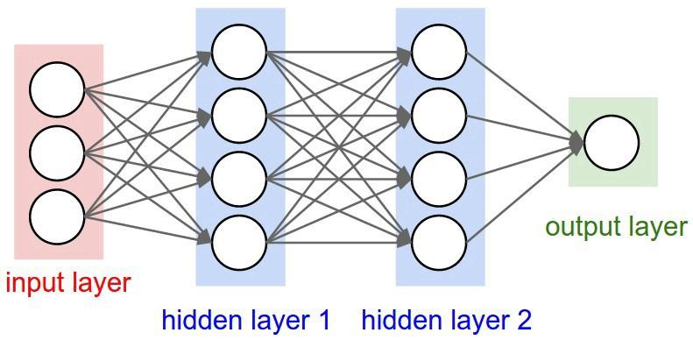

Slide 5
Types of ML Problems
Supervised Learning
Regression
Classification
Unsupervised Learning
Clustering
Association rule learning
Structured output
Ranking

Slide 6
Linear Regression
Training and Testing
Loss
Hands-On(Celsius to Fahrenheit)

Slide 7
Hands-On: Celsius to Fahrenheit

Slide 8
Classification
Binary Classification
Multi-class classification
Hands-On(Text Classification with IMDB or Translation)

Slide 9
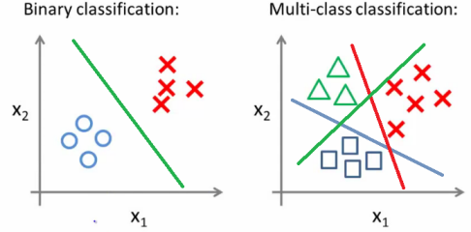

Slide 10
Hands-On: Text classification with movie reviews using IMDB Dataset

Slide 11
Thank You

